Slide 1
Ghana Adventures Business Insights
by: GROUP JANNS
Nhyira Ninson | Suzzy Lartey | Jeremiah Elorm Aleawobu
7th April, 2025

Slide 2
Table of Contents
Thesis
Executive Summary
Introduction
Overall Insights
Business Problem
Off-Peak Season Analysis
Package Analysis
Customer Analysis
Conclusion

Slide 3
Thesis
Leveraging Data Analytics to Optimize Tour Bookings and Customer Retention for Ghana Adventures
This report explores how data analytics can help Ghana Adventures address critical business challenges—such as inconsistent seasonal bookings, low repeat customer rates, and underperforming tour packages—by uncovering patterns, predicting customer behavior, and informing strategic decisions to boost operational efficiency and growth.

Slide 4
Executive Summary
Ghana Adventures generated GHS 54K from 76 customers, with strong
seasonal trends—peak seasons bringing in more revenue and bookings.
However, customer retention is low, with over 55% being one-time clients.
Top-performing tour packages (e.g., New Year Safari, Volta River Cruise)
significantly outperform others, while booking channels like Travel Agencies
and Websites are the most effective. Individual bookings are most common,
though group and private tours present growth opportunities.
Recommendations:
Use seasonal trends to predict demand and run timely promotions.
Boost repeat customers through loyalty programs and targeted offers.
Invest in high-performing booking channels; optimize low ones.
Rebrand or bundle underperforming tours.
Promote group/corporate packages to increase off-peak bookings.

Slide 5
Introduction
Ghana Adventures is a growing travel and tour company based in Tamale, offering a range of services including domestic and international travel, corporate packages, and adventure tours such as safaris and eco-tourism. Despite a broad service offering, the company faces significant challenges: fluctuating seasonal demand, a low percentage of repeat customers, and uneven performance across its tour packages.
This report aims to provide data-driven insights into customer booking behavior, seasonal trends, and tour package performance. By analyzing historical sales and customer data, we seek to understand the key factors influencing booking patterns and customer loyalty. The data collected includes customer demographics, booking channels, tour types, seasonality, and repeat bookings. The ultimate purpose is to use these insights to predict demand, improve tour bookings, and increase customer retention—ensuring sustainable growth for Ghana Adventures.

Slide 6
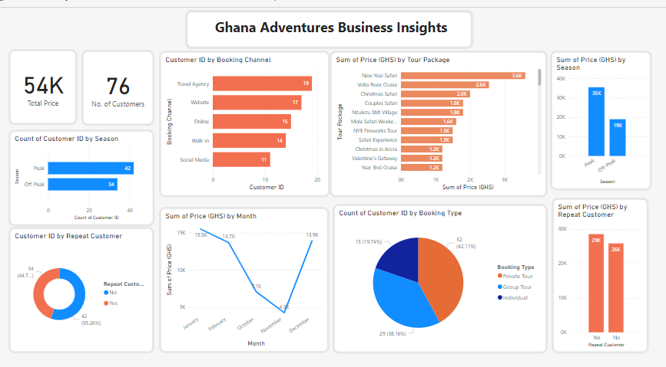
Overall Insights

Slide 7
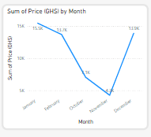
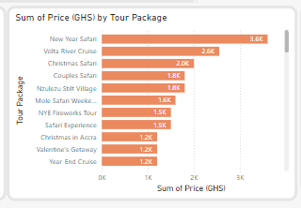
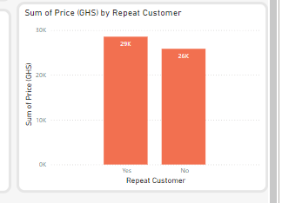
Business Problem
1. Peak season vs Slow season
2. Sales of Tour Packages
3. Customer return rate and spending

Slide 8
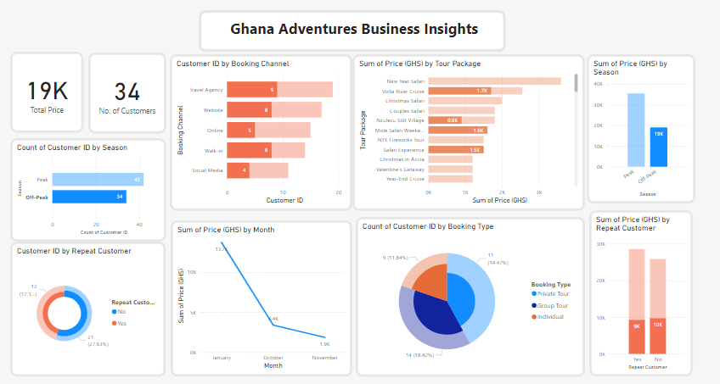
Business Insights
Off-Peak Season Analysis
Recommendations
Offer lucrative promotions and discounts especially in February, December.
Survey customer adventure preferences during off-peak most especially in February and December
Using targeted marketing campaigns on social media to create discounts and promotion awareness.

Slide 9
Business Insights
Package Analysis
Recommendations
No Package should be discontinued since they bring profit.
Packages less than GHS 2000.00 should adjusted to contain all customer feedback and preferences.
Packages above GHS 2000.00 should be expanded with more experiential treats and luxury.

Slide 10
Business Insights
Customer Analysis
Recommendations
Issuing membership cards second timers where the card allows members to discounts, no waiting time in bookings, card bearers who refer friends or family enjoy free treats like free tours, subsidized tour prices.

Slide 11
Conclusion
This report provided a comprehensive analysis of customer booking behaviors, seasonal trends, and revenue patterns for Ghana Adventures. The insights revealed key challenges such as inconsistent seasonal demand, low customer retention, and underperforming tour packages.
Peak seasons contribute significantly more to revenue and bookings compared to off-peak months, indicating an opportunity for targeted marketing and promotional strategies during slower periods. Additionally, while a portion of customers return for repeat bookings, a larger percentage are one-time clients, emphasizing the need for loyalty programs and improved customer engagement.
High-performing tour packages such as the New Year Safari and Volta River Cruise show strong demand, while others lag behind and may require rebranding or replacement. Furthermore, digital channels like websites and online platforms are becoming essential booking sources, though social media remains underutilized.
To address these challenges, data-driven recommendations were proposed—ranging from seasonal promotions and personalized marketing to loyalty incentives and optimized package offerings. By leveraging these insights, Ghana Adventures can enhance customer experiences, improve repeat business, and increase overall tour bookings.

Slide 12

Thank You!

Slide 14
...and our sets of editable icons
You can resize these icons without losing quality.
You can change the stroke and fill color; just select the icon and click on the paint bucket/pen.
In Google Slides, you can also use Flaticon’s extension, allowing you to customize and add even more icons.

Slide 15
Educational Icons
Medical Icons

Slide 16
Business Icons
Teamwork Icons

Slide 17
Help & Support Icons
Avatar Icons

Slide 18
Creative Process Icons
Performing Arts Icons

Slide 19
Nature Icons

Slide 20
SEO & Marketing Icons

